Slide 1


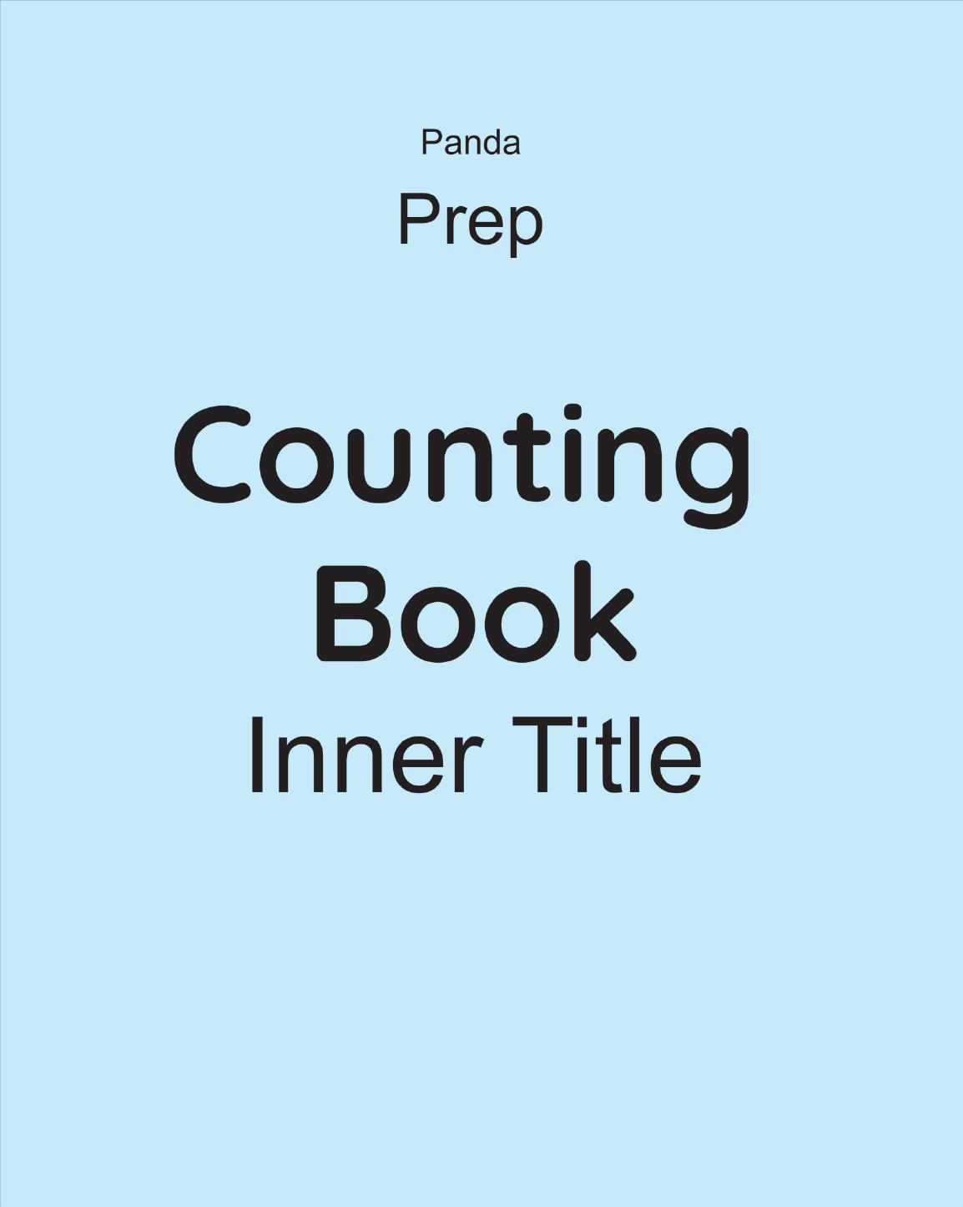
Panda Counting Book
Prep • Age 5+
An activity-based early-years book from the Panda Series.
A Project of Azhar Publishers & Book Factory

Slide 2
i
What's Inside
Panda Counting Book Prep • Age 5+
1
Numbers to 100 with number words
2
Greater than, less than, before/after/between
3
Ascending & descending order, ordinal numbers
4
Addition — sentences, totals, number line, word problems
5
Subtraction — from 10, number line, word problems
6
Positions, shapes and telling the time

Slide 3
★
Purpose & Classroom Support
Builds confident early-maths skills — larger numbers, comparing, addition and subtraction with word problems, and everyday concepts — ready for school.
“
Every book comes with
1
2
3
Teacher's Lesson Plan
Practice Papers
Digital Interactive Version
A 40-week lesson plan that guides teachers, day by day.
Monthly tests and term exam papers for children to attempt.
An interactive flipbook and digital exercises for engaging, screen-based practice.
A Project of Azhar Publishers & Book Factory

